Slide 1

Assignment 1 – COMP-472
James Partsafas - 40170301,
Ghaith Chrit - 40114180,
Samuel Collette - 40175048

Slide 2
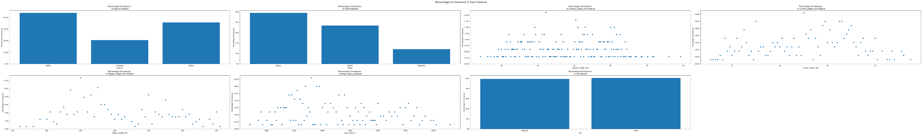
Analyzing Penguin dataset

Slide 3
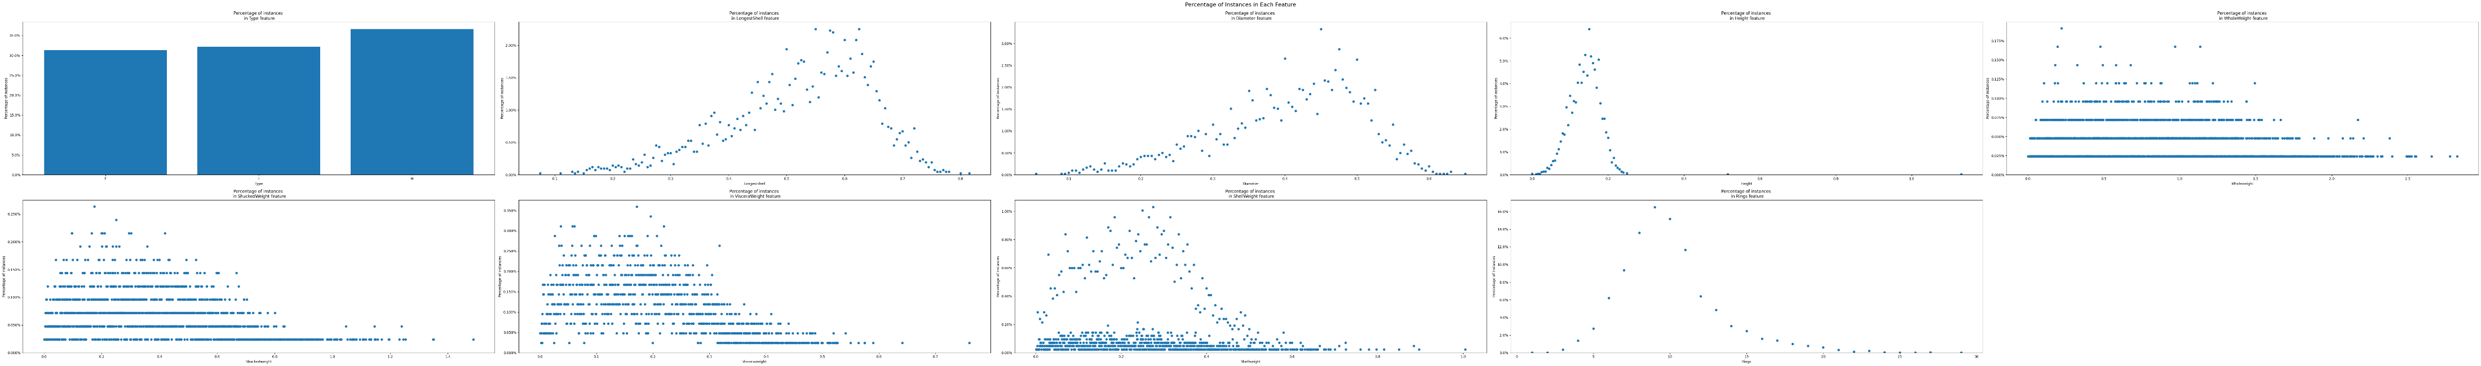
Analyzing Abalone dataset

Slide 4
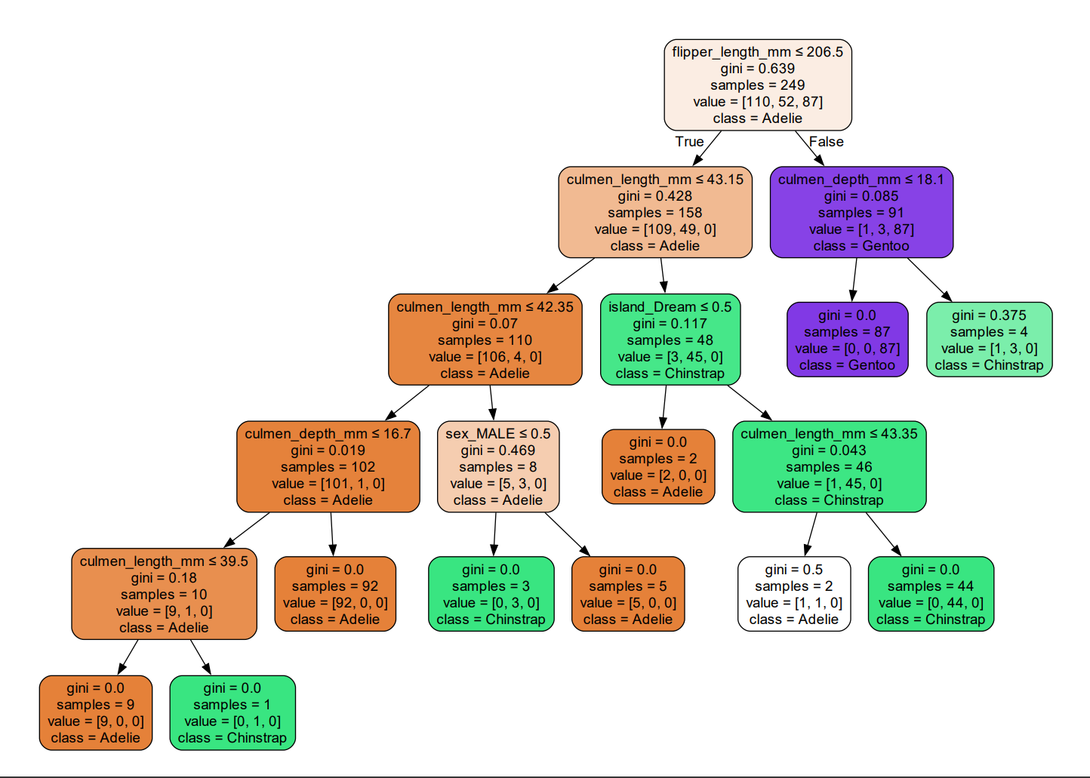
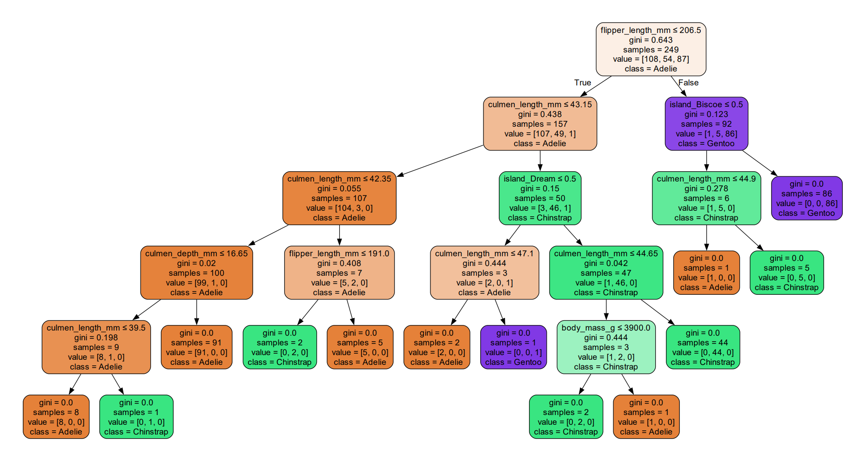
Decision trees for Penguin dataset

Slide 5
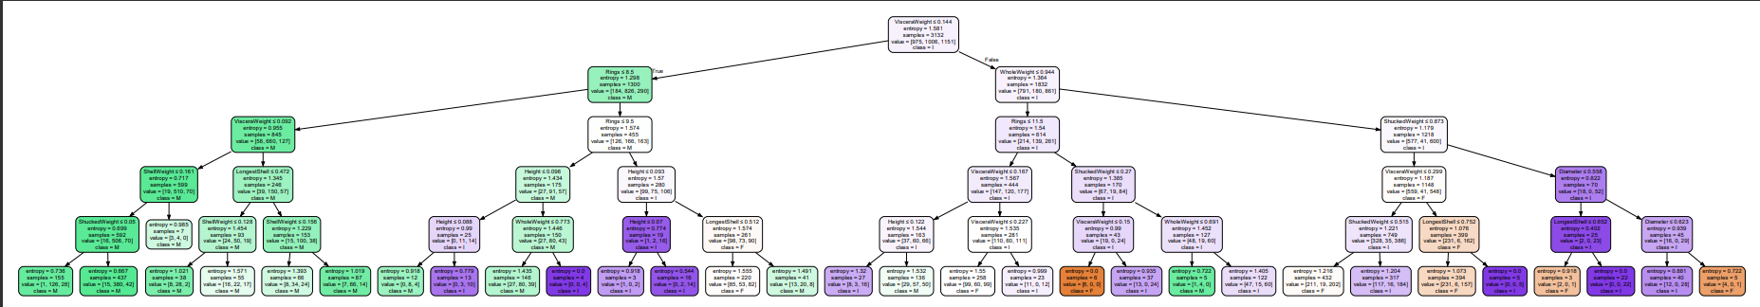
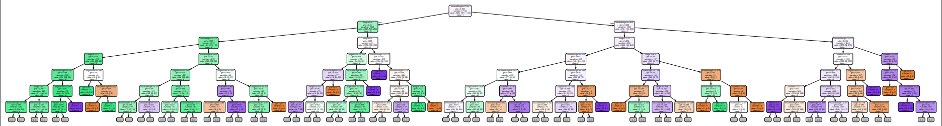
Decision trees for Abalone dataset

